Slide 1
Knowing the Real God

Slide 2
Know the Real God ?
How can I …
Exodus 33: 12-23 Moses
Job 23: 3 Job
1 Timothy 1:17 To the King eternal, immortal, invisible, the only true God

Slide 3
Knowing the Real Mart

Slide 4
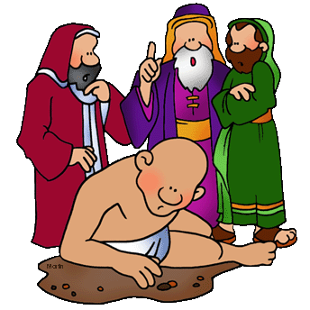
God wants us to know Him
… intimately
Intimacy means that you know me (YADA—to know deeply)
Job 19:14
all my intimate friends detest me
Alone

Slide 5
God wants us to know Him
… intimately
Intimacy means that you know me (YADA—to know deeply)
Jeremiah 1: 5 Before I formed you in the womb I knew you
Psalm 139: 1-4 God knows our every thought, emotion
and motivation

Slide 6
God wants us to know Him
… intimately
Intimacy means that I can know you. (SOD—to reveal / disclose)
Proverbs 3: 32 the Lord … takes the upright into his confidence
NIV
God is intimate with the upright
NASB

Slide 7
God wants us to know Him
… intimately
Intimacy means that you care about me.
(SAKAN—to be of use to)
Psalm 139: 3 You are familiar with all my ways NIV
or … intimately acquainted with all my ways NASB
WHY this beneficial / caring involvement?
Psalm 139: 10 in order to guide us and make us secure

Slide 8
Knowing the Real God
John 14: 5-12 The disciples wanted to know God, the Father
John 14: 7 If you really knew me you would know my Father
as well.
If you had got to know me through our relationship
together you would know, have seen, my Father
as well.
John 14: 8 Show us the Father
: 9 Don’t you know me, Philip, even after such a long
time?
Anyone who has seen me has seen the Father

Slide 9
Our view of God impacts
every aspect of our life
Love for God
Self concept
Relationships with others
Experience of God’s Word

Slide 10
Our view of God impacts
every aspect of our life
Adverse circumstances in the past:
Family relationship
Religious experience
Painful life event

Slide 11
Knowing the Real God
1 John 2: 3 We know that we have come to know him
(i.e. Jesus) if we obey his commands
John 14:15 If you love me, you will keep my commandments
NASB
An Inspecting God
A Disappointed God
A Distant God

Slide 12
I could benefit from experiencing more of Jesus as:
The “welcoming” Jesus Luke 19: 5
The “encouraging” Jesus Luke 22: 32
The “compassionate” Jesus John 11: 35
The “embracing” Jesus Matthew 19: 15
The “lovingly confrontational” Jesus John 8: 10
The “caring” Jesus Matthew 17: 27
The “honouring” Jesus Matthew 15: 28

Slide 13
A Prayer
Fill my heart, Holy Spirit, with the wonder of an embracing,
celebrating Christ;
may my joy and gratitude for being so loved
empower my love for others.
Release in me, heavenly Father, that love for others around
me with the same caring initiative.
Make my heart especially sensitive to passing on your love
to …

